Slide 1
CE 395 R5- Data Mining Data Mining with WEKA (Data Preprocessing)

Slide 2
WEKA: the software
WEKA: Data Mining Software in Java
The Explorer
Data Preprocessing
Classification and Regression
Clustering
Association Rules
Attribute Selection
Data Visualization
The Experimenter
The Knowledge Flow GUI
Conclusions

Slide 3
WEKA: the software (2)
Machine learning/data mining software written in Java (distributed under the GNU Public License)
Used for research, education, and applications
Complements “Data Mining” by Witten & Frank
Main features:
Comprehensive set of data pre-processing tools, learning algorithms and evaluation methods
Graphical user interfaces (incl. data visualization)
Environment for comparing learning algorithms

Slide 4
WEKA: versions
There are several versions of WEKA:
WEKA 3.0: “book version” compatible with description in data mining book
WEKA 3.2: “GUI version” adds graphical user interfaces (book version is command-line only)
WEKA 3.3: “development version” with lots of improvements
Version installed in the lab is WEKA 3.6.13

Slide 5
WEKA only deals with “flat” files
@relation heart-disease-simplified
@attribute age numeric
@attribute sex { female, male}
@attribute chest_pain_type { typ_angina, asympt, non_anginal, atyp_angina}
@attribute cholesterol numeric
@attribute exercise_induced_angina { no, yes}
@attribute class { present, not_present}
@data
63,male,typ_angina,233,no,not_present
67,male,asympt,286,yes,present
67,male,asympt,229,yes,present
38,female,non_anginal,?,no,not_present
...
Flat file in
ARFF format

Slide 6
WEKA only deals with “flat” files
@relation heart-disease-simplified
@attribute age numeric
@attribute sex { female, male}
@attribute chest_pain_type { typ_angina, asympt, non_anginal, atyp_angina}
@attribute cholesterol numeric
@attribute exercise_induced_angina { no, yes}
@attribute class { present, not_present}
@data
63,male,typ_angina,233,no,not_present
67,male,asympt,286,yes,present
67,male,asympt,229,yes,present
38,female,non_anginal,?,no,not_present
...
numeric attribute
nominal attribute

Slide 7
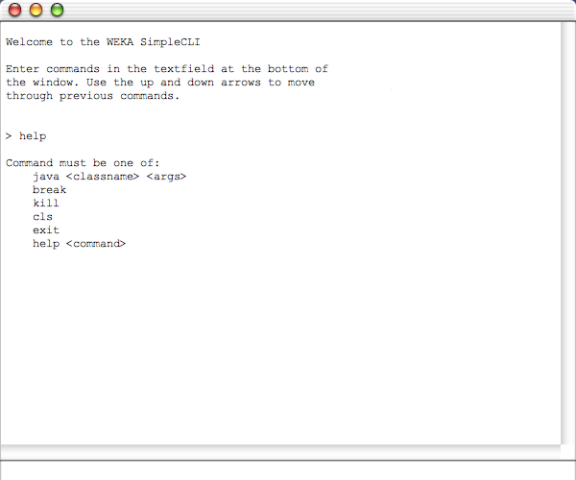
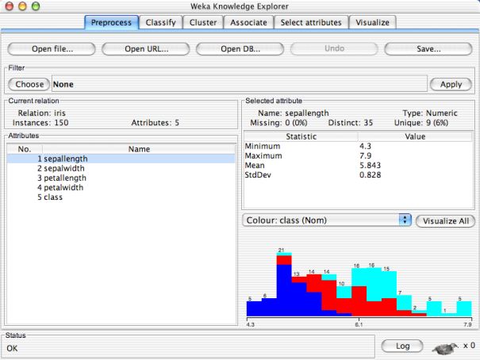
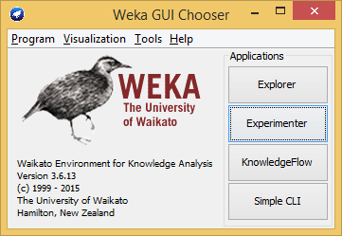
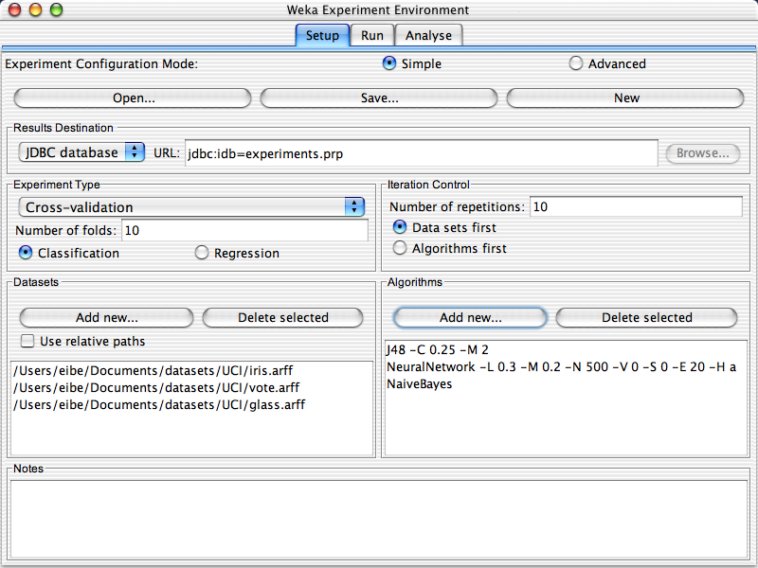
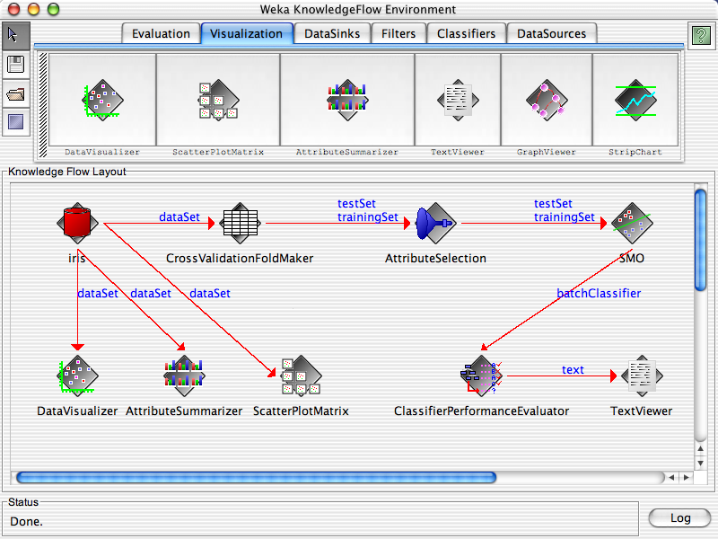

Slide 10
Explorer: pre-processing the data
Data can be imported from a file in various formats: ARFF, CSV, C4.5, binary
Data can also be read from a URL or from an SQL database (using JDBC)
Pre-processing tools in WEKA are called “filters”
WEKA contains filters for:
Discretization, normalization, resampling, attribute selection, transforming and combining attributes, …

Slide 11
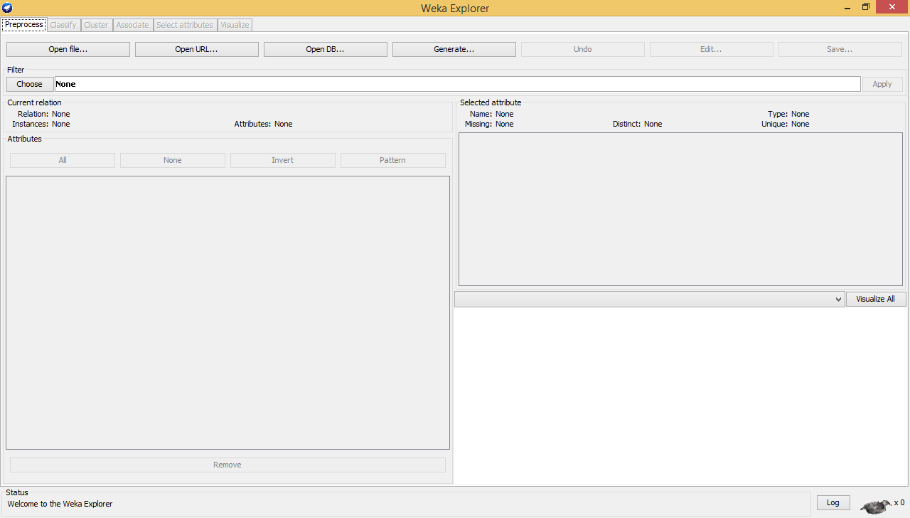

Slide 13
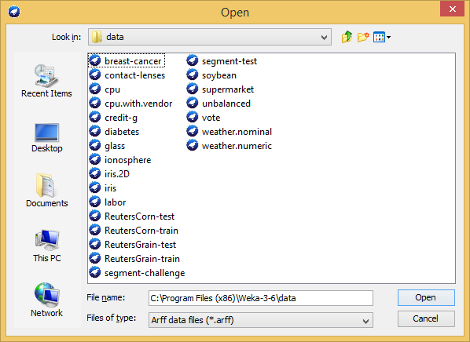

Slide 14
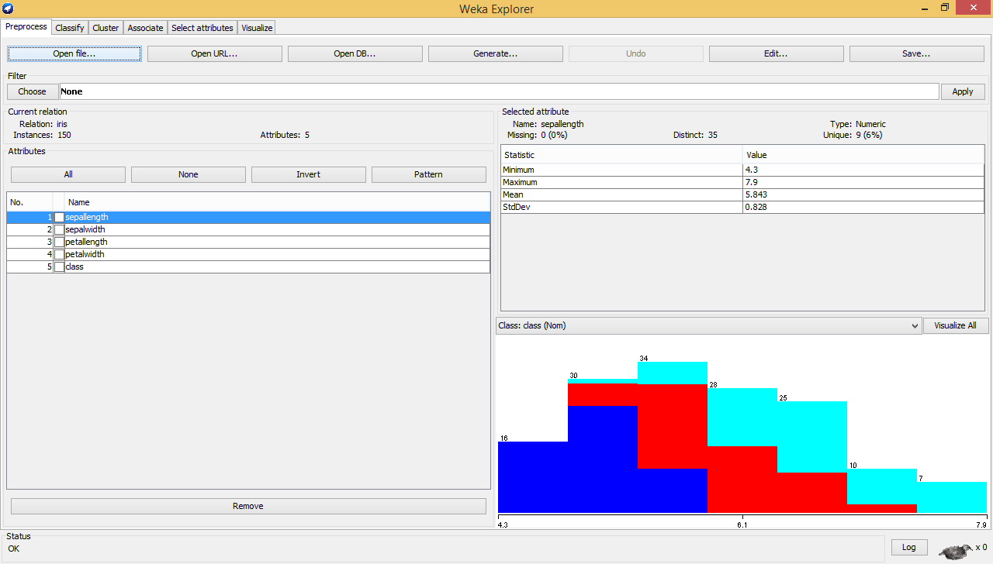

Slide 16
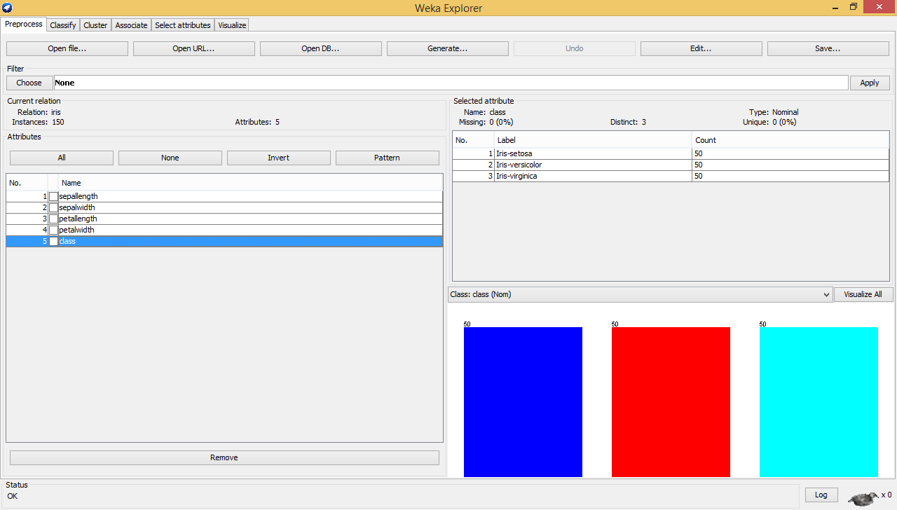

Slide 17
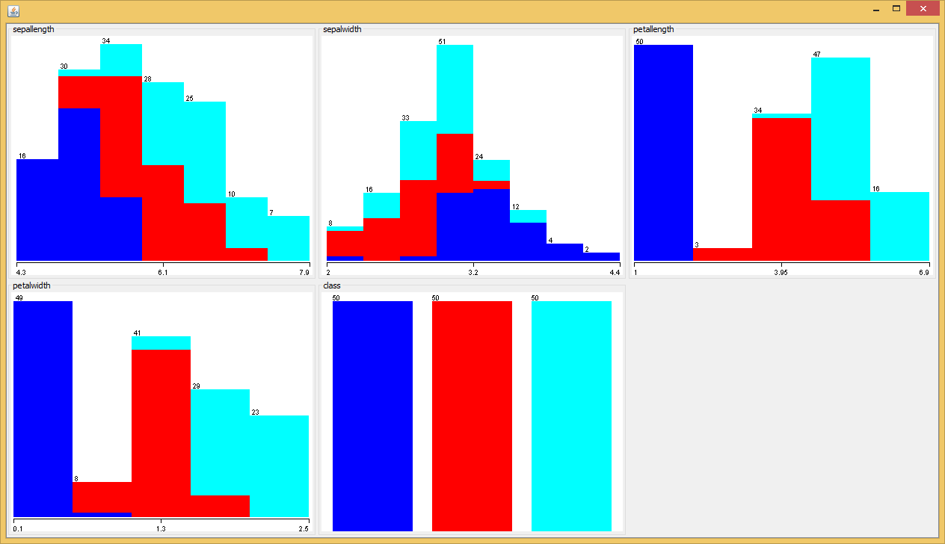

Slide 18
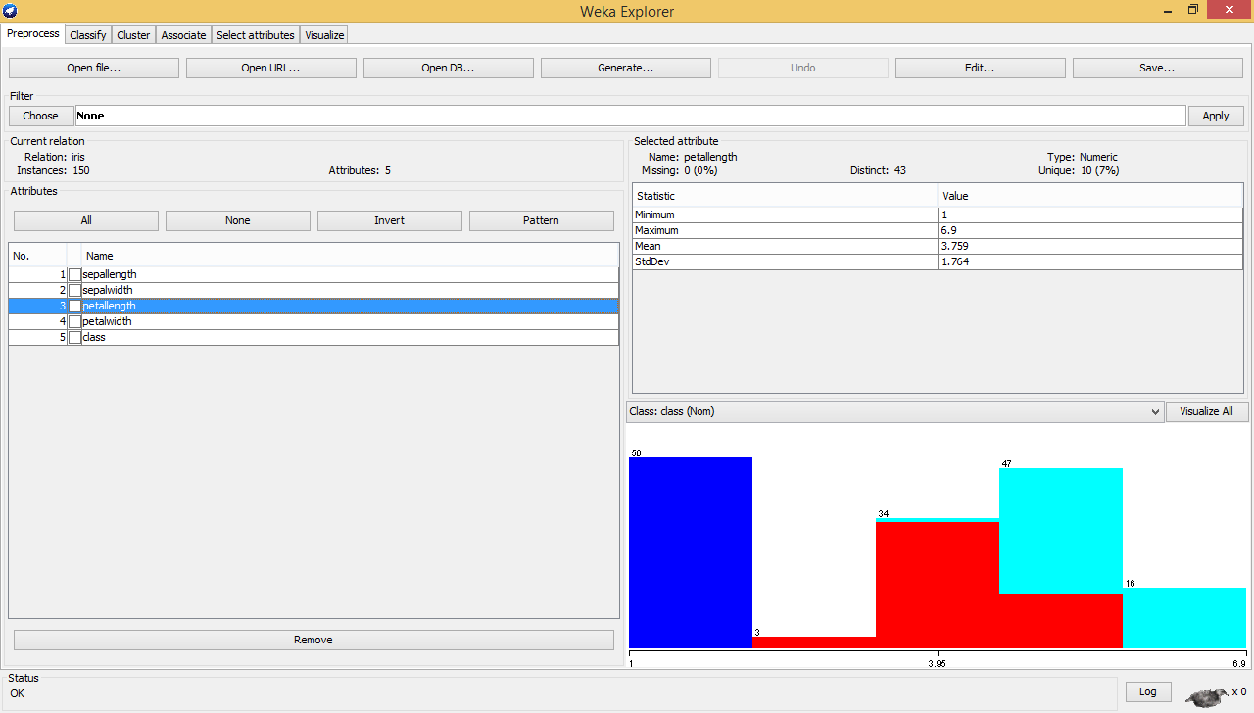

Slide 20
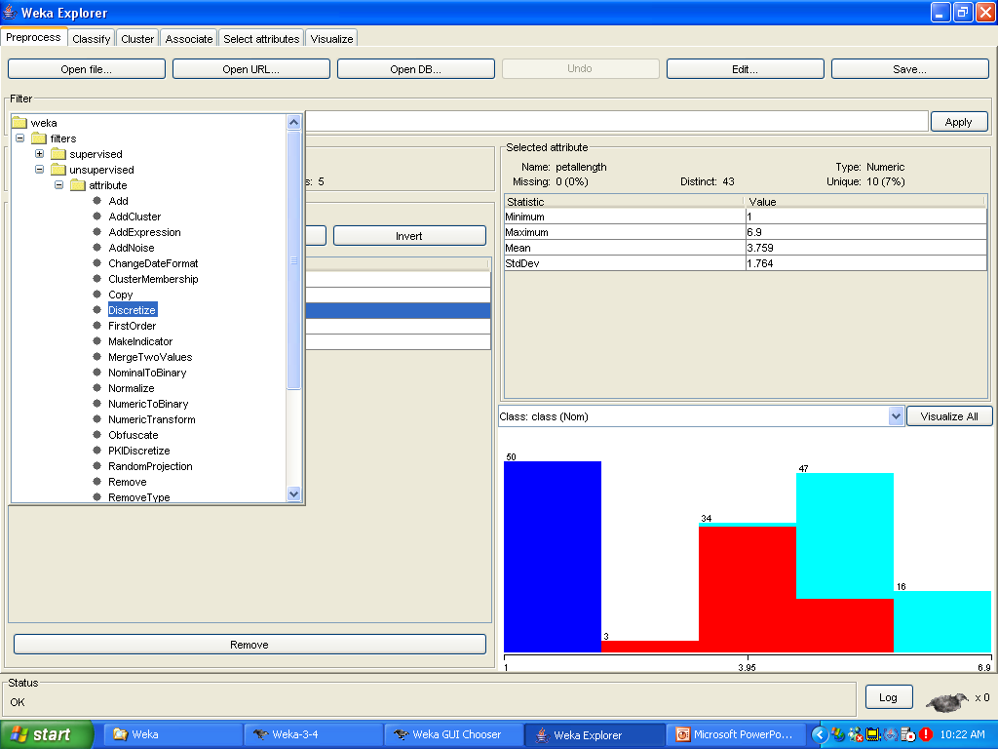

Slide 21
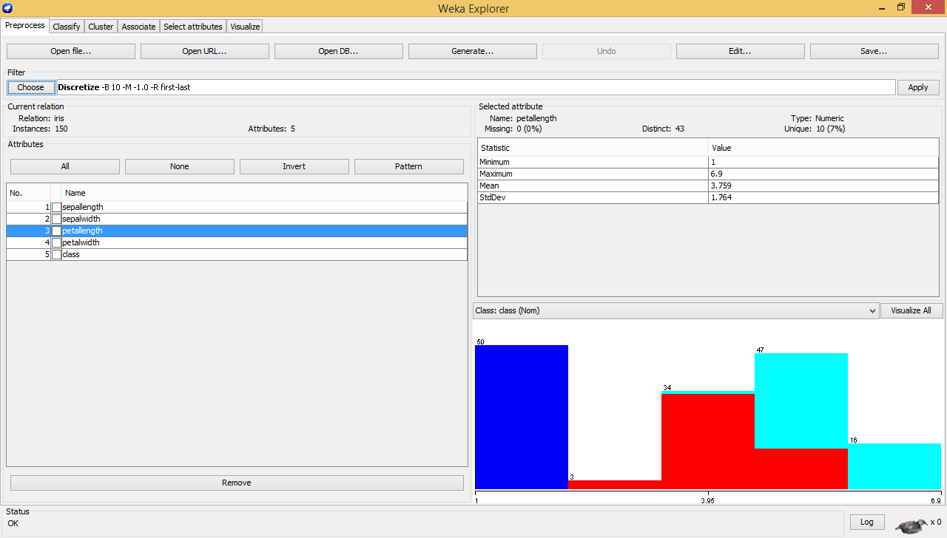

Slide 22
right-click

Slide 23
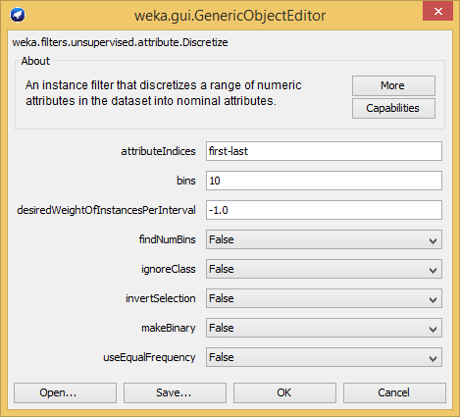

Slide 25
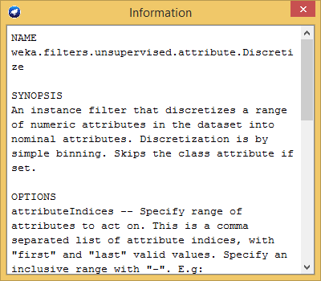

Slide 27
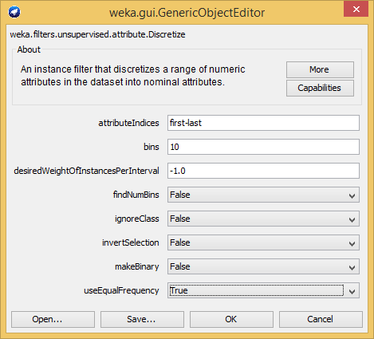

Slide 29


Slide 31
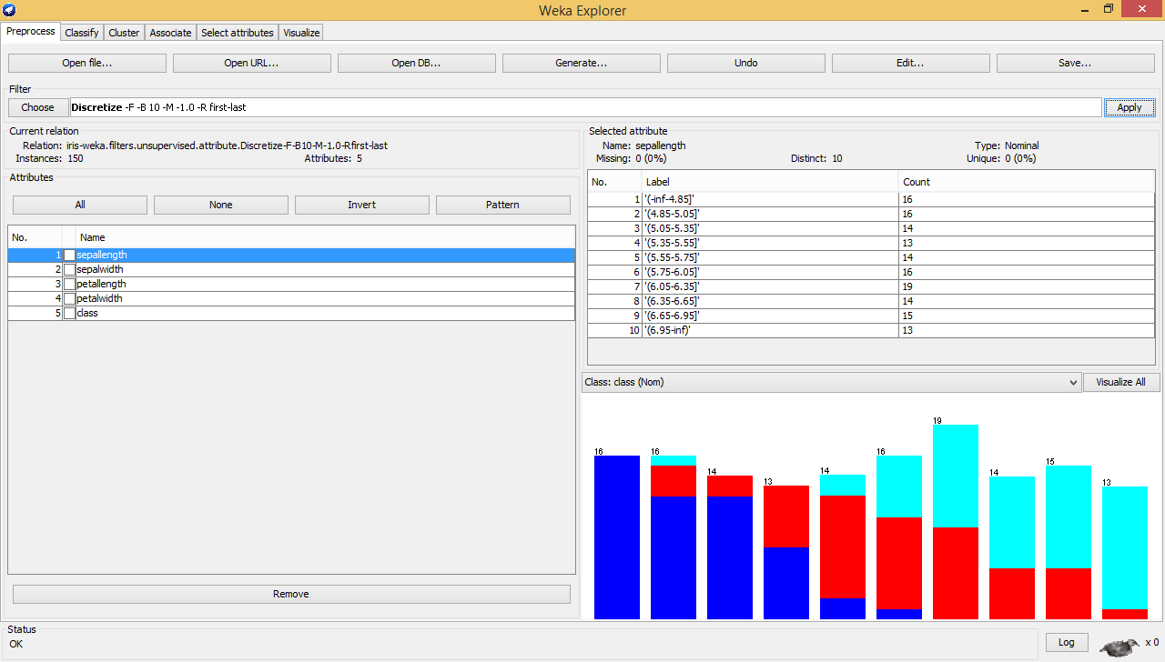

Slide 34


Slide 36
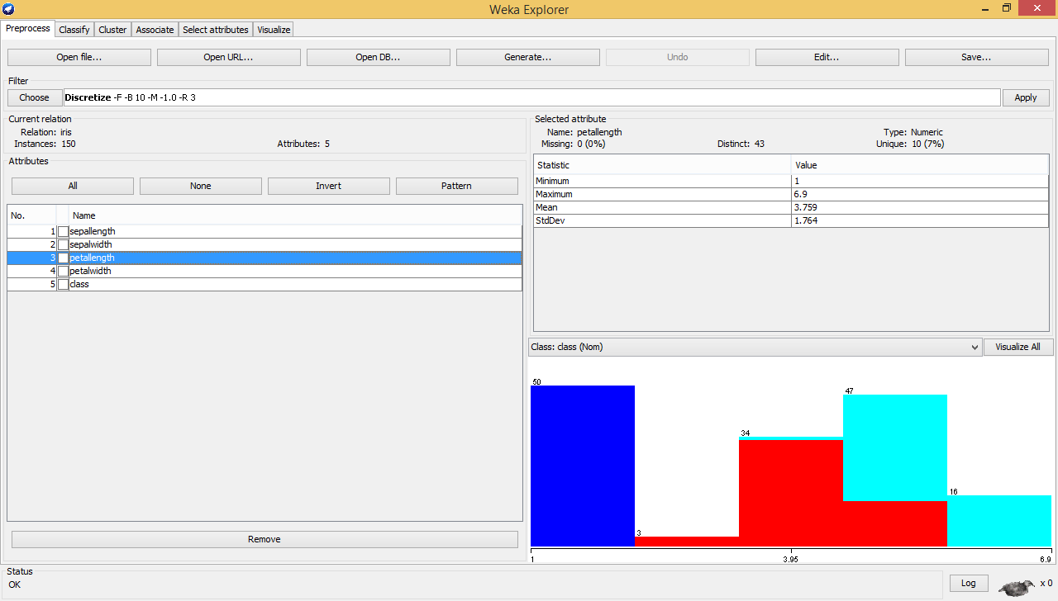

Slide 37
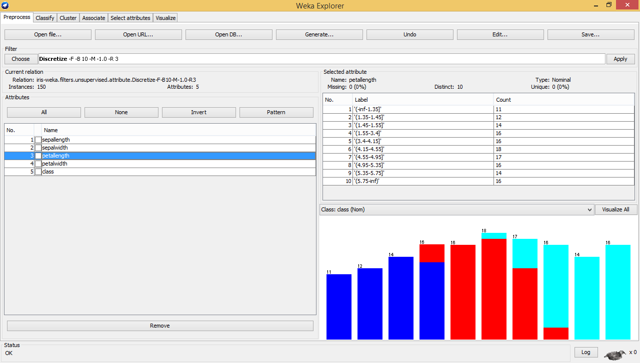
Now, only attribute #3 is discretized

Slide 38
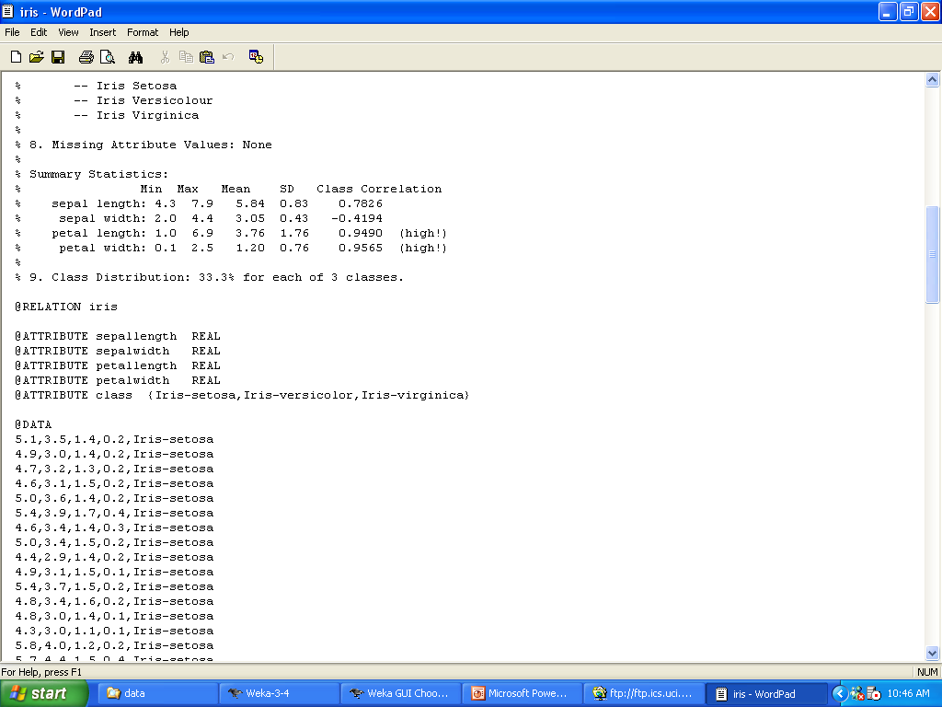
iris.arrf

Slide 39
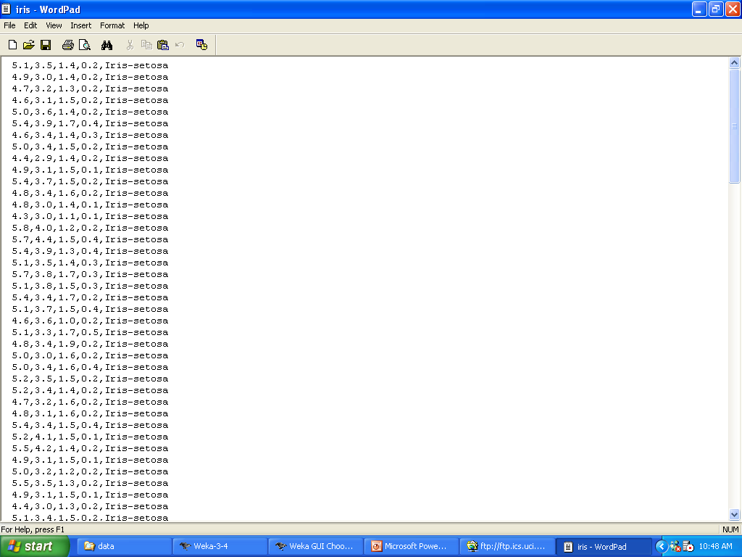
iris.arrf
iris.txt

Slide 40
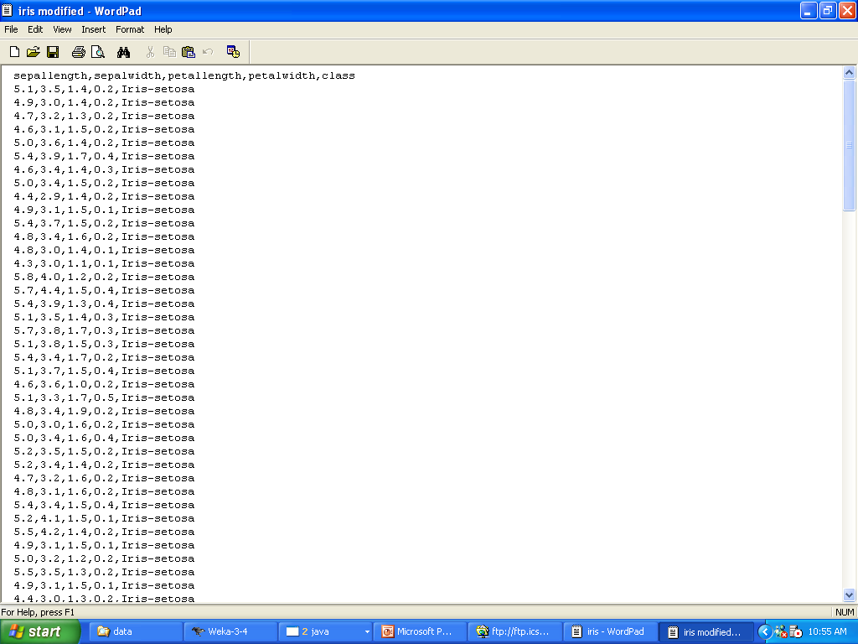
first row
iris modified.txt

Slide 41
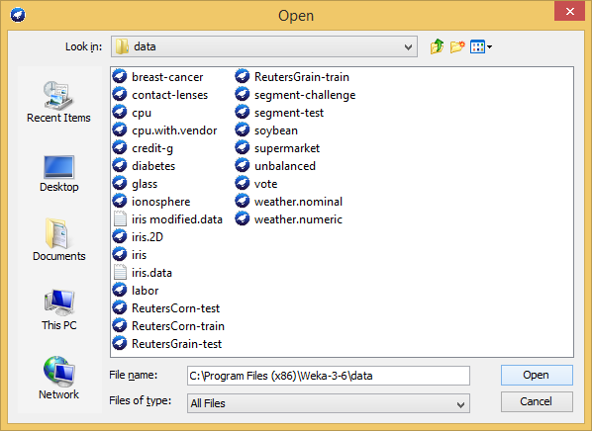

Slide 43
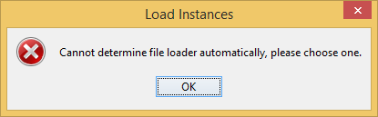

Slide 44
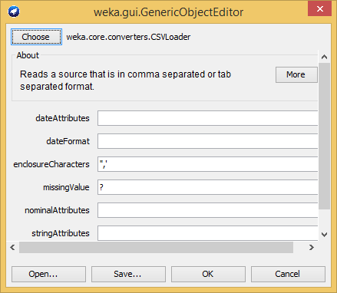

Slide 45


Slide 46
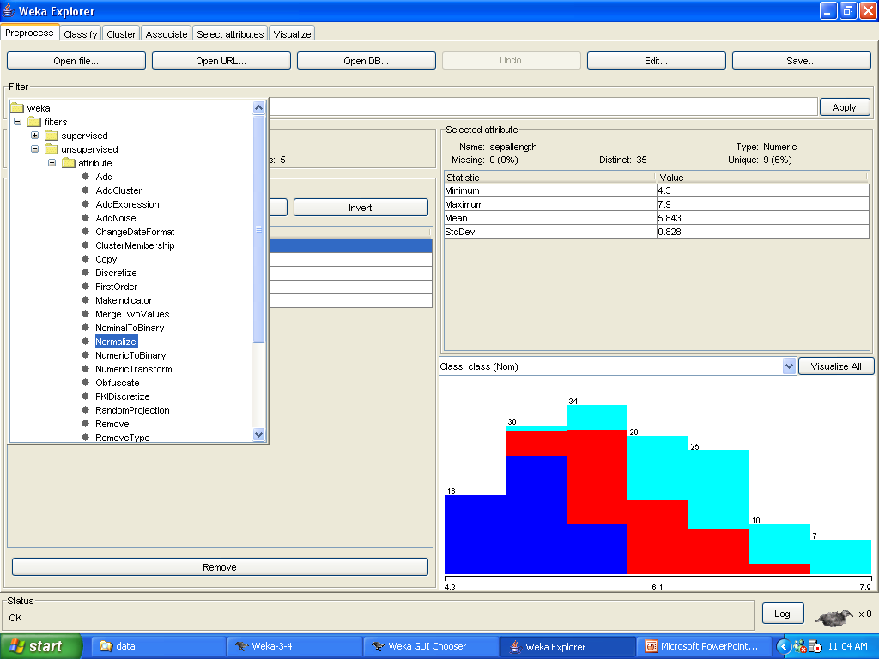

Slide 47

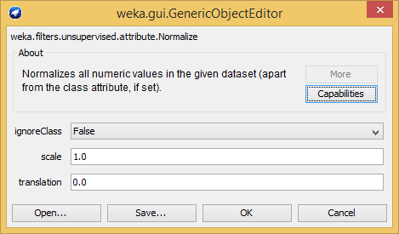
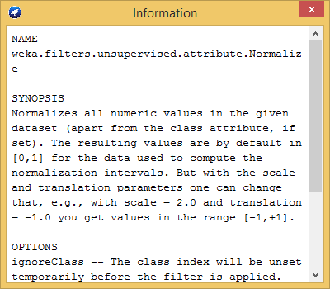

Slide 48
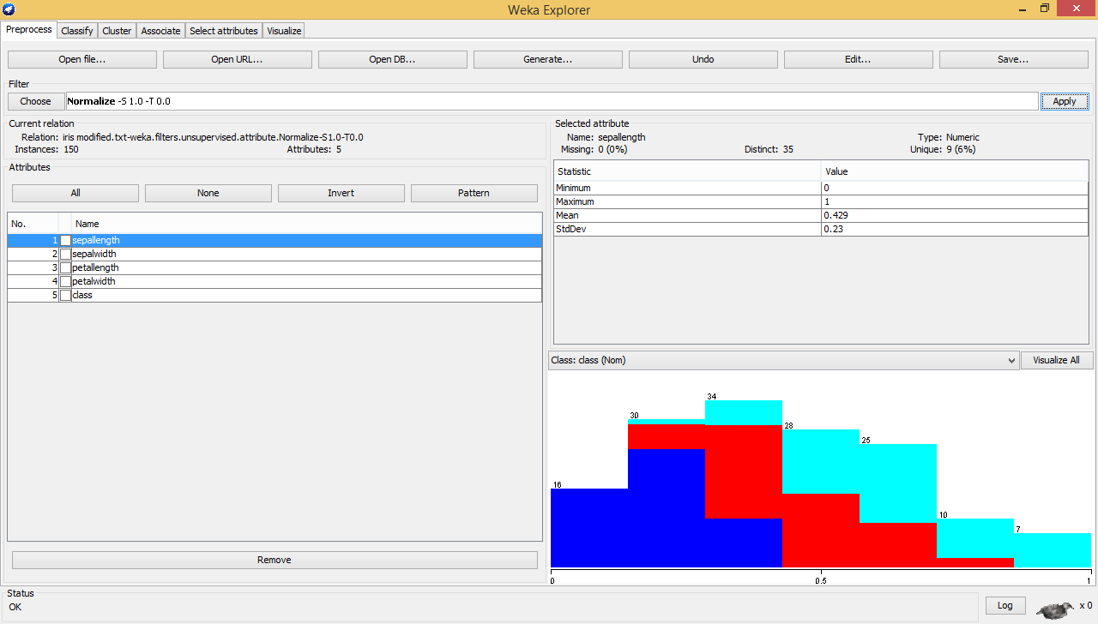

Slide 51
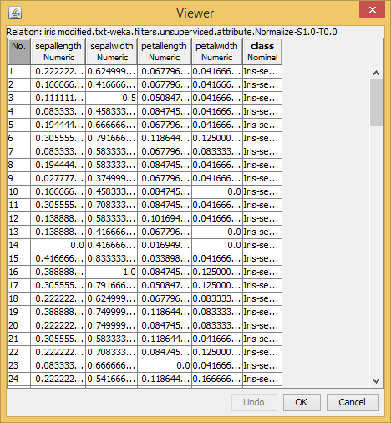

Slide 53
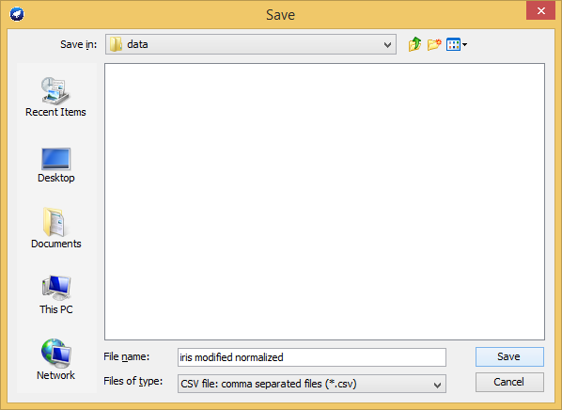

Slide 54
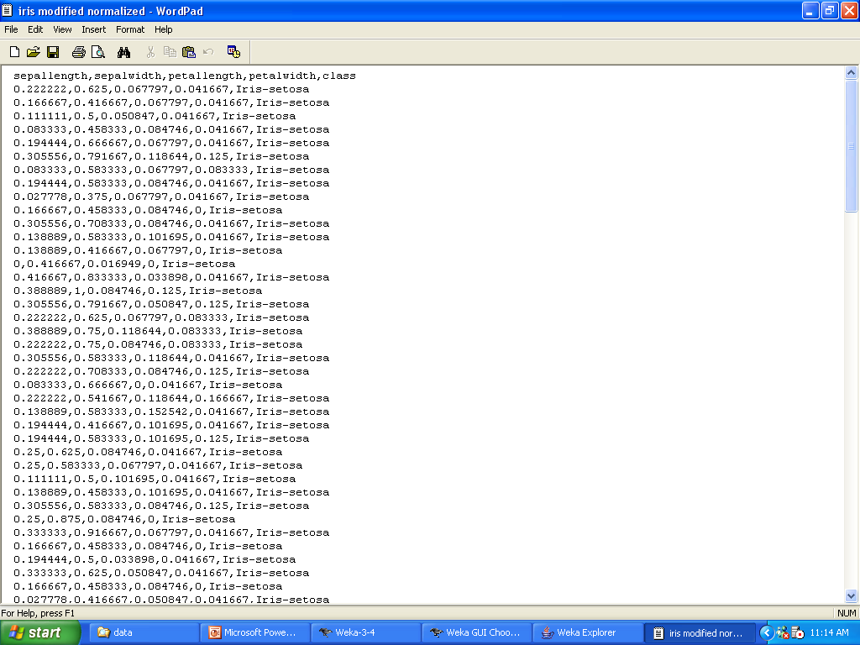

Slide 55
Exercise
Open “glass” database
Discretize attribute “Fe” in 5 bins using a Weka function
Undo
Normalize all attributes using a Weka function
Undo
Normalize attribute “Si” using min-max normalization and 0-1 scale.
Calculate Euclidian Distance between record 1 and record 207

